Slide 1
Tutorial 1 - Week 2
We’ll be starting at the 10 minute mark

Slide 2
Agenda
TA Introductions
Logistics
Introduction to PyCharm IDE
Programming concepts: types, variables, operators, expressions, errors
Practice problems
Questions?

Slide 3
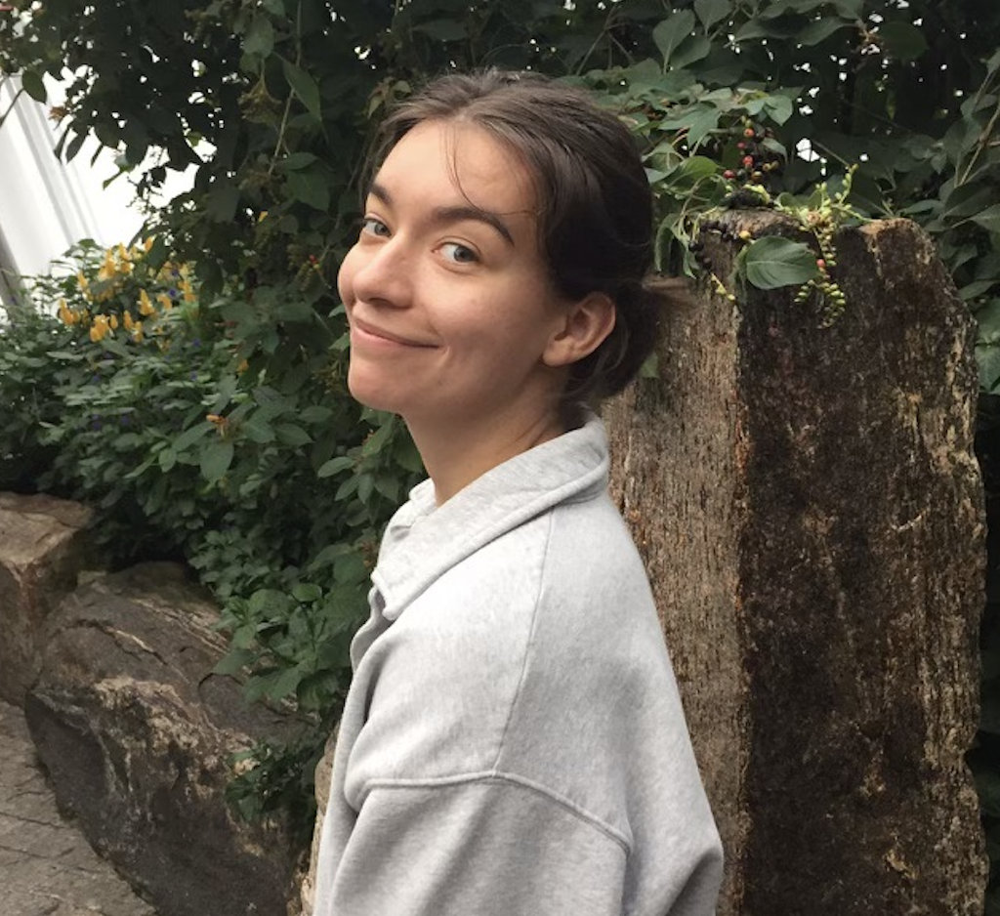
Introduction - TA
Katia Ossetchkina
(TUT08)
Current studies: Second year MASc CIV Student
Research/other interests: Automated image processing for fracture analysis in rocks

Slide 4
Tutorial Logistics
Tutorials are for your benefit - no grading
We will review previous weeks labs & lecture content
Be sure to ask lots of questions and have Python open. We are here to help you!
Questions outside of tutorial time?
Post to Piazza - all TAs/instructors and your peers can answer questions quickly
Coffee Time – drop-in hours for 1on1 help

Slide 5

Coffee Time With TAs!
These are hours for any extra help you need for the course or programming in general 🙂
also known as office hours
Please go to the following link to submit your response.
https://forms.gle/4NeZXciXTnUBZFTQ7

Slide 6
Virtual Tutorial and Virtual Labs! !
Please go to the following links to submit your response.
Tutorial:
https://forms.gle/CPC5waK4m4wJgQnp9
Labs:
https://forms.gle/2GrSNK7BoNPafjYr7

Slide 7
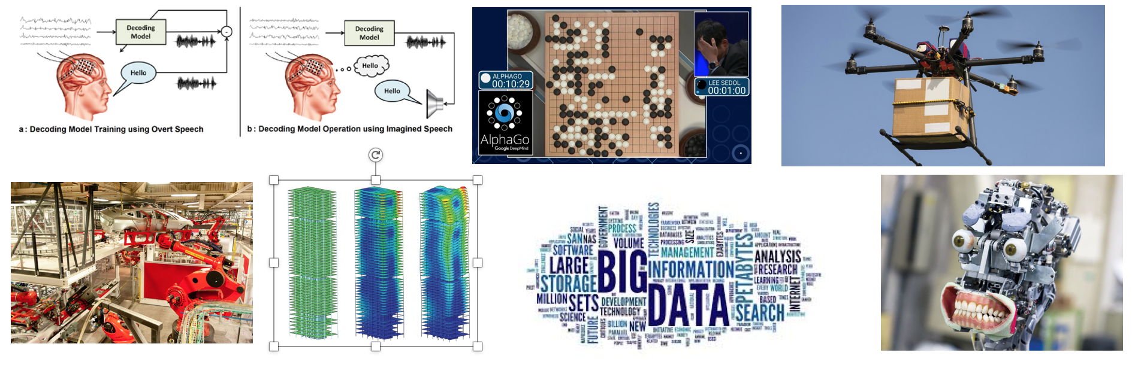
Why code?¹
Programming is awesome!
Computers are everywhere, programming is a boundless opportunity
Software engineering can be applied to almost any context in the world

Slide 8
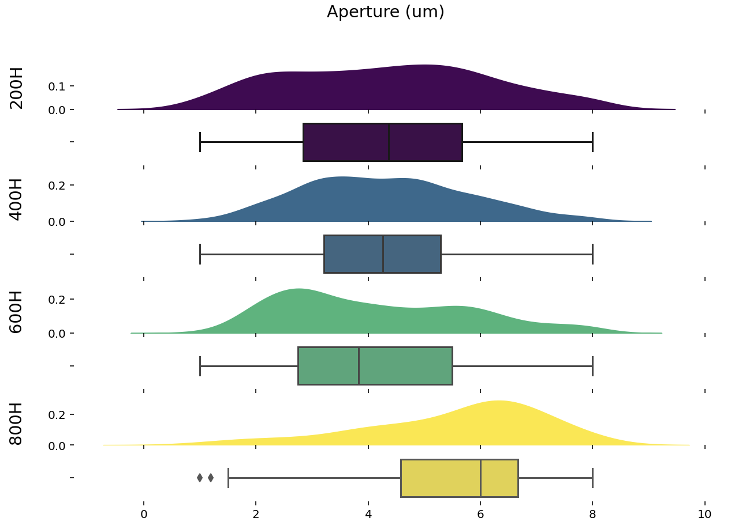
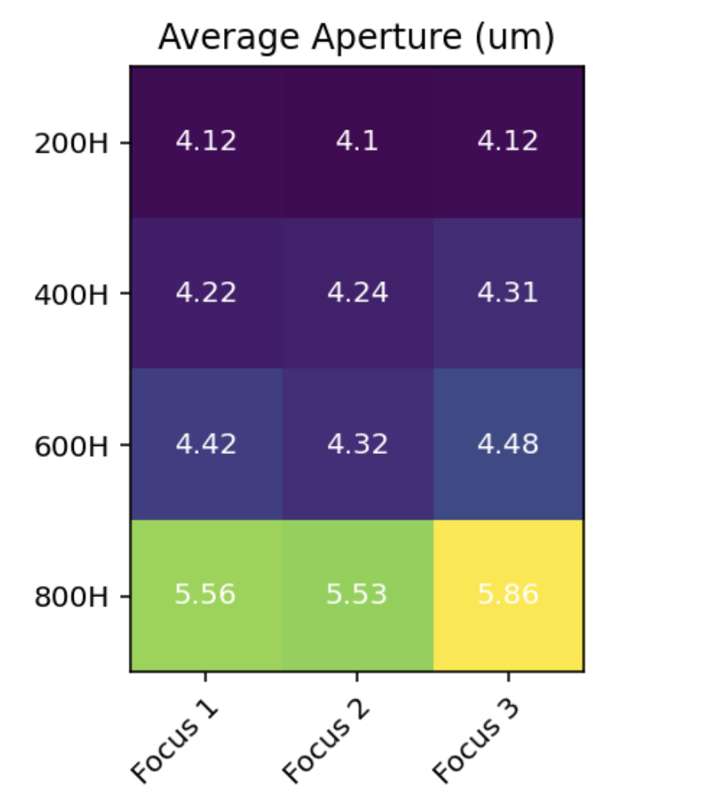
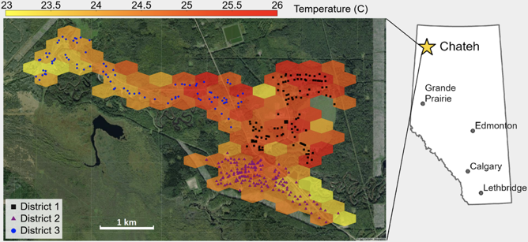
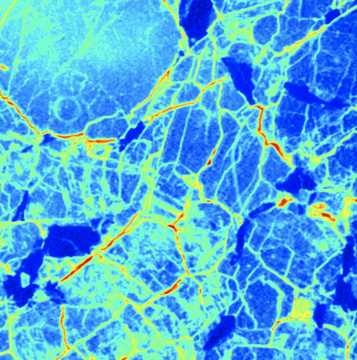
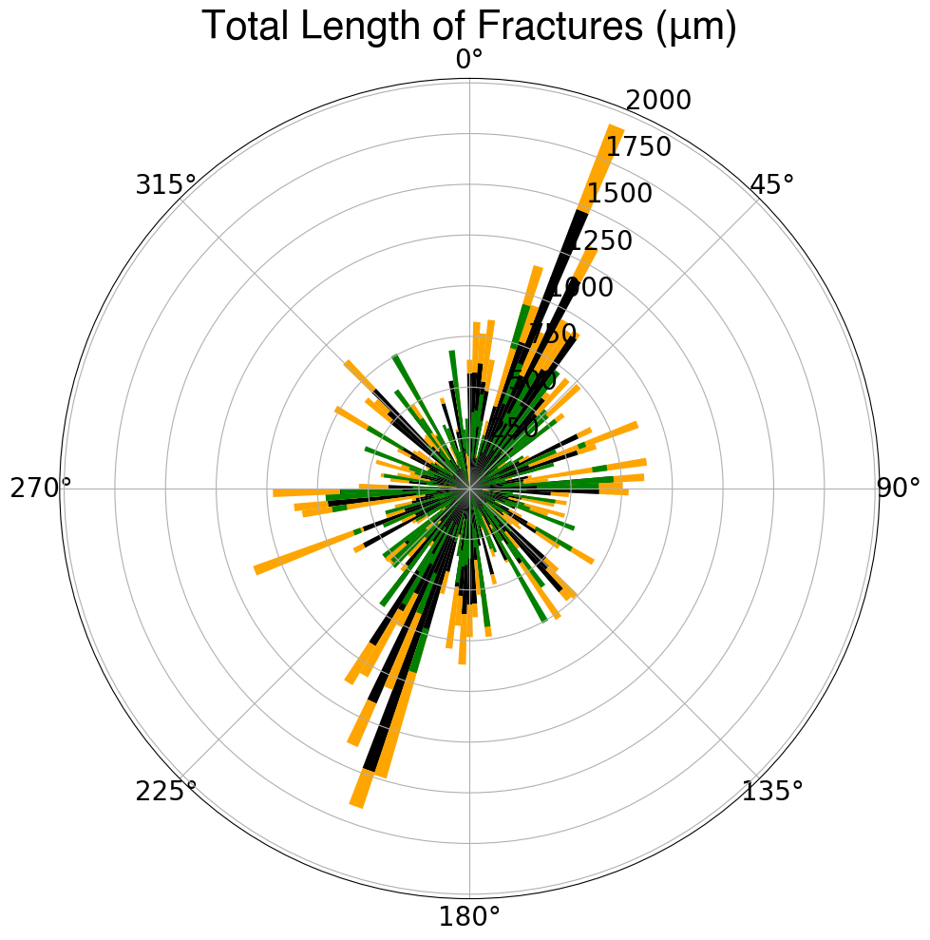
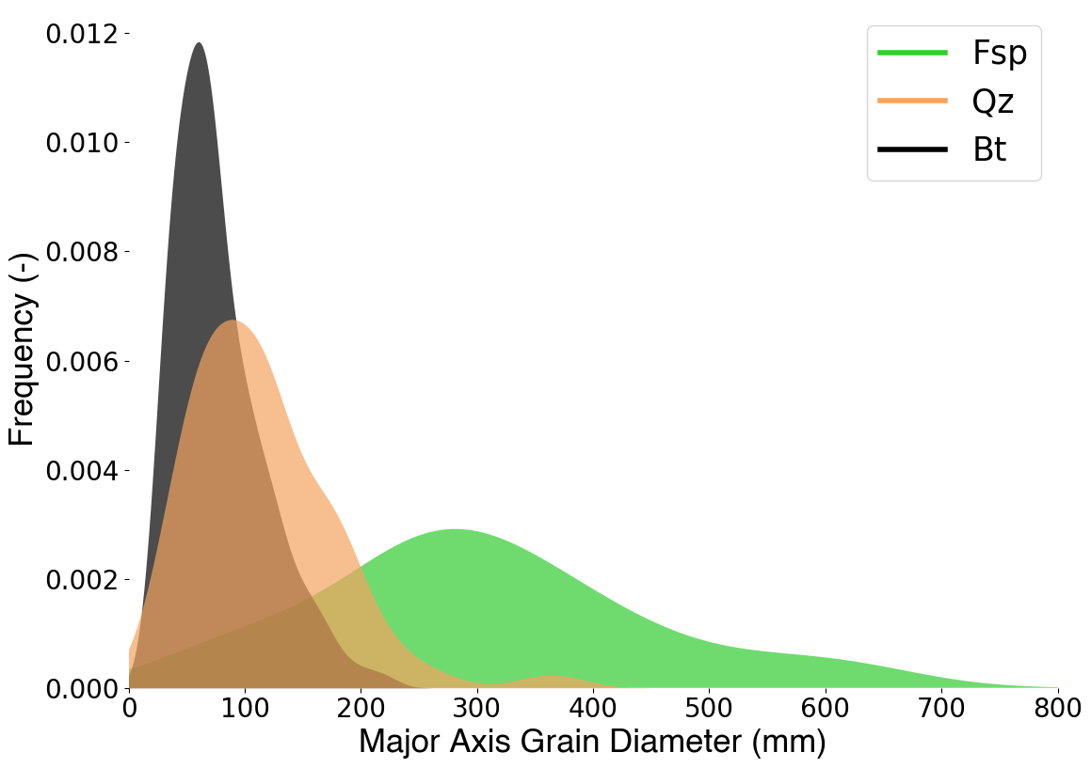
Why code?²
Regardless of background, coding is always an achievable skill
Software engineering can be applied to almost any context in the world
NEVER THINK THAT YOU “CAN'T UNDERSTAND” CODING
Notes:
Replace with your figures

Slide 9
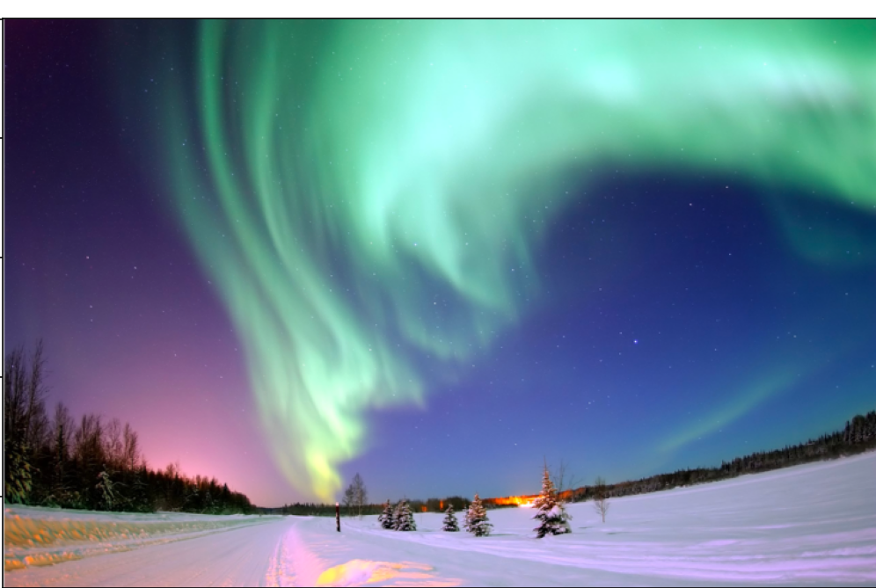
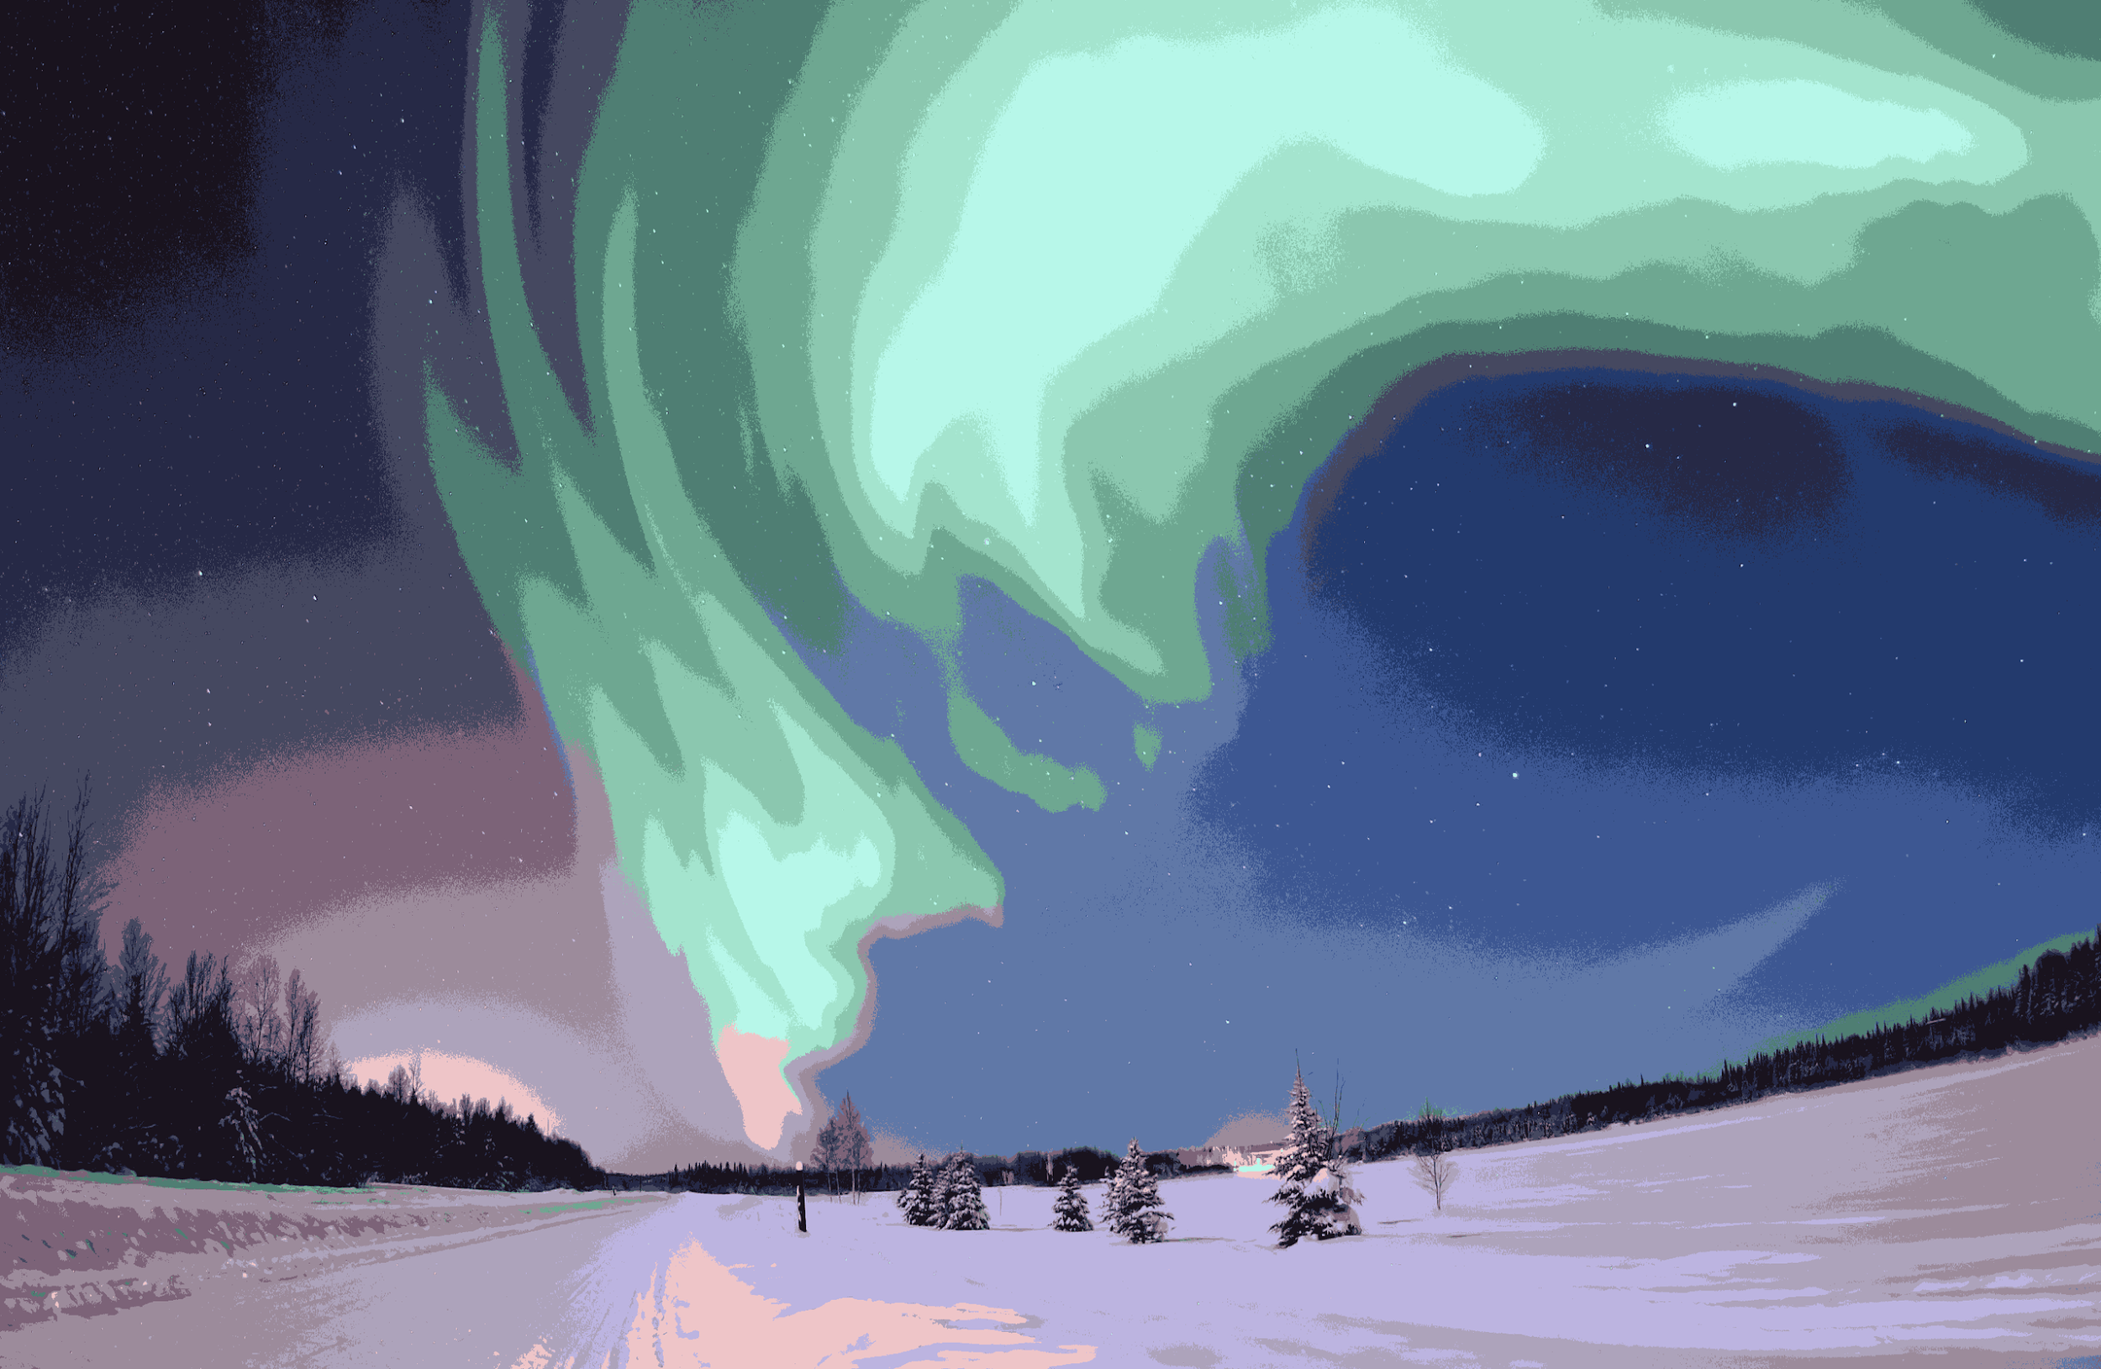
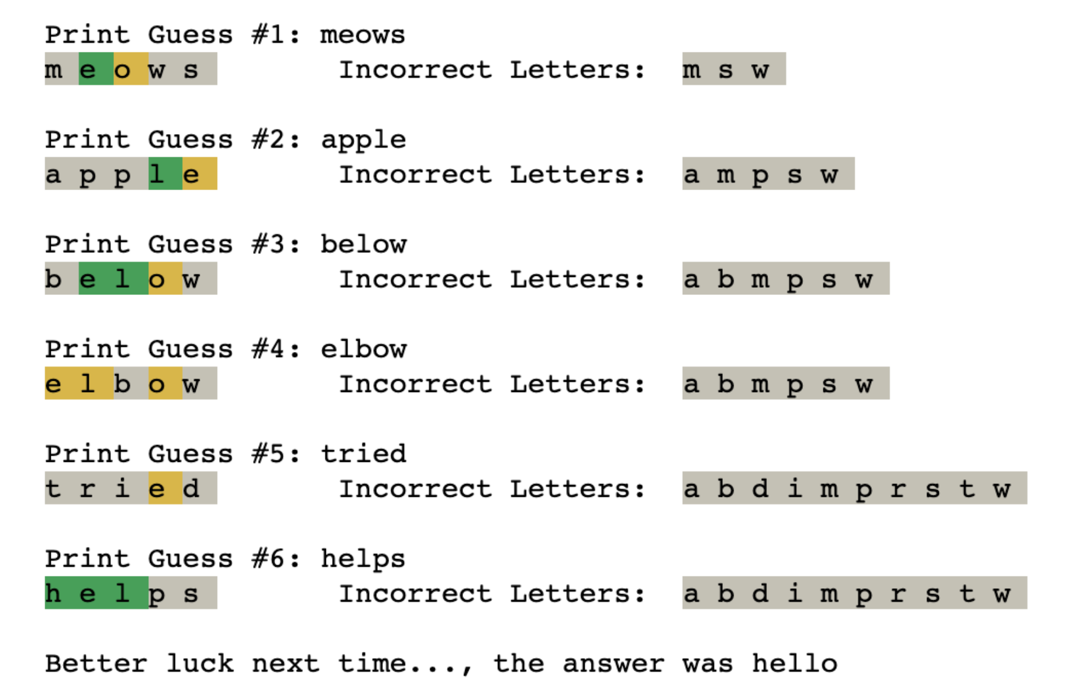
Why code?²
Regardless of background, coding is always an achievable skill
Software engineering can be applied to almost any context in the world
NEVER THINK THAT YOU “CAN'T UNDERSTAND” CODING
Original Image
SLIC Segmentation
Notes:
Replace with your figures

Slide 10

What would you want to ideally learn how to do with computers?

Slide 11


What would you want to ideally learn how to do with computers?
ⓘ
Click Present with Slido or install our Chrome extension to activate this poll while presenting.
Notes:
📣 This is Slido interaction slide, please don't delete it. ✅ Click on 'Present with Slido' and the poll will launch automatically when you get to this slide.

Slide 12
Coding experience?

Slide 13

How would you rate your coding experience?
ⓘ
Click Present with Slido or install our Chrome extension to activate this poll while presenting.
Notes:
📣 This is Slido interaction slide, please don't delete it. ✅ Click on 'Present with Slido' and the poll will launch automatically when you get to this slide.

Slide 14
Intro to PyCharm IDE

Slide 15
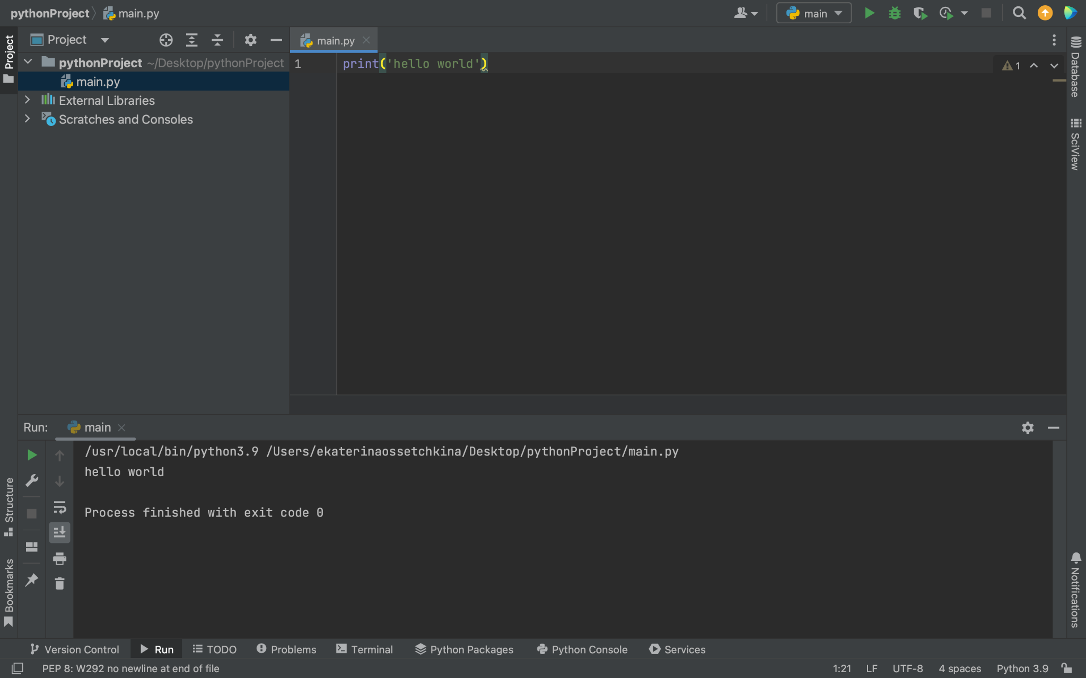
PyCharm
PyCharm is an Integrated Development Environment
Script/program editing window
Python Shell

Slide 16
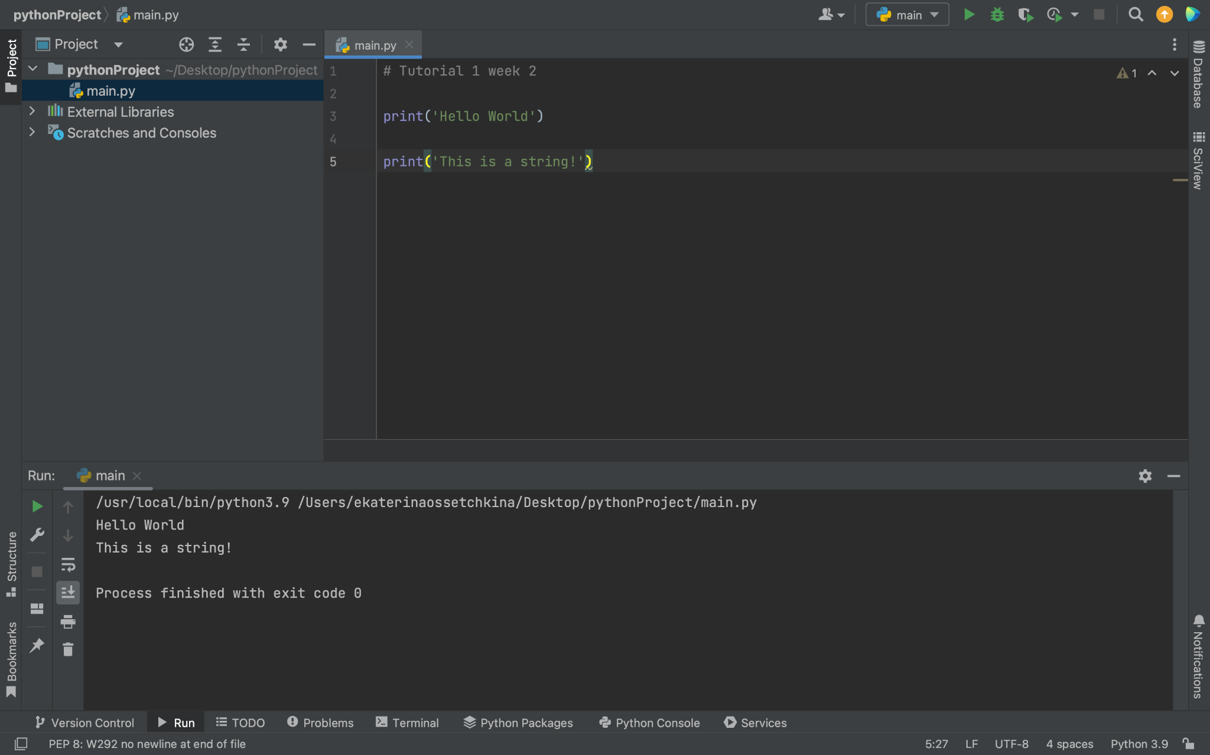
Click on the green chevron to run your code
Script Name
Single-line comments. They start with a “#”
Tip: Use these to make your script easier to follow
Statements that will be executed
Python version in use. Make sure you are using Python3 !
Python code can be written and run directly in the shell

Slide 17
Programming Concepts
Values, Types, and Variables

Slide 18
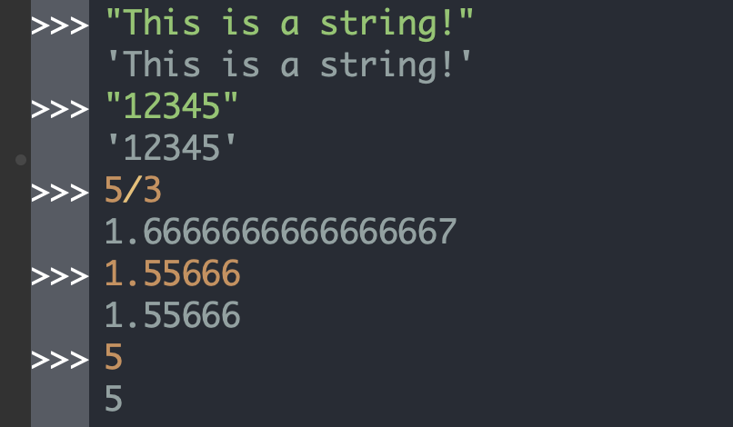
Values and Types in Programming
Value: the representation of some entity that can be manipulated by a program, e.g., 5.
Type: a set of values and the operations that can be performed on those values
Examples of Python types and values:
int: the set of integer numbers
sample value:
float: the set of (double-precision) floating-point numbers
sample value:
str: the set of sequences of characters
sample values:

Slide 19
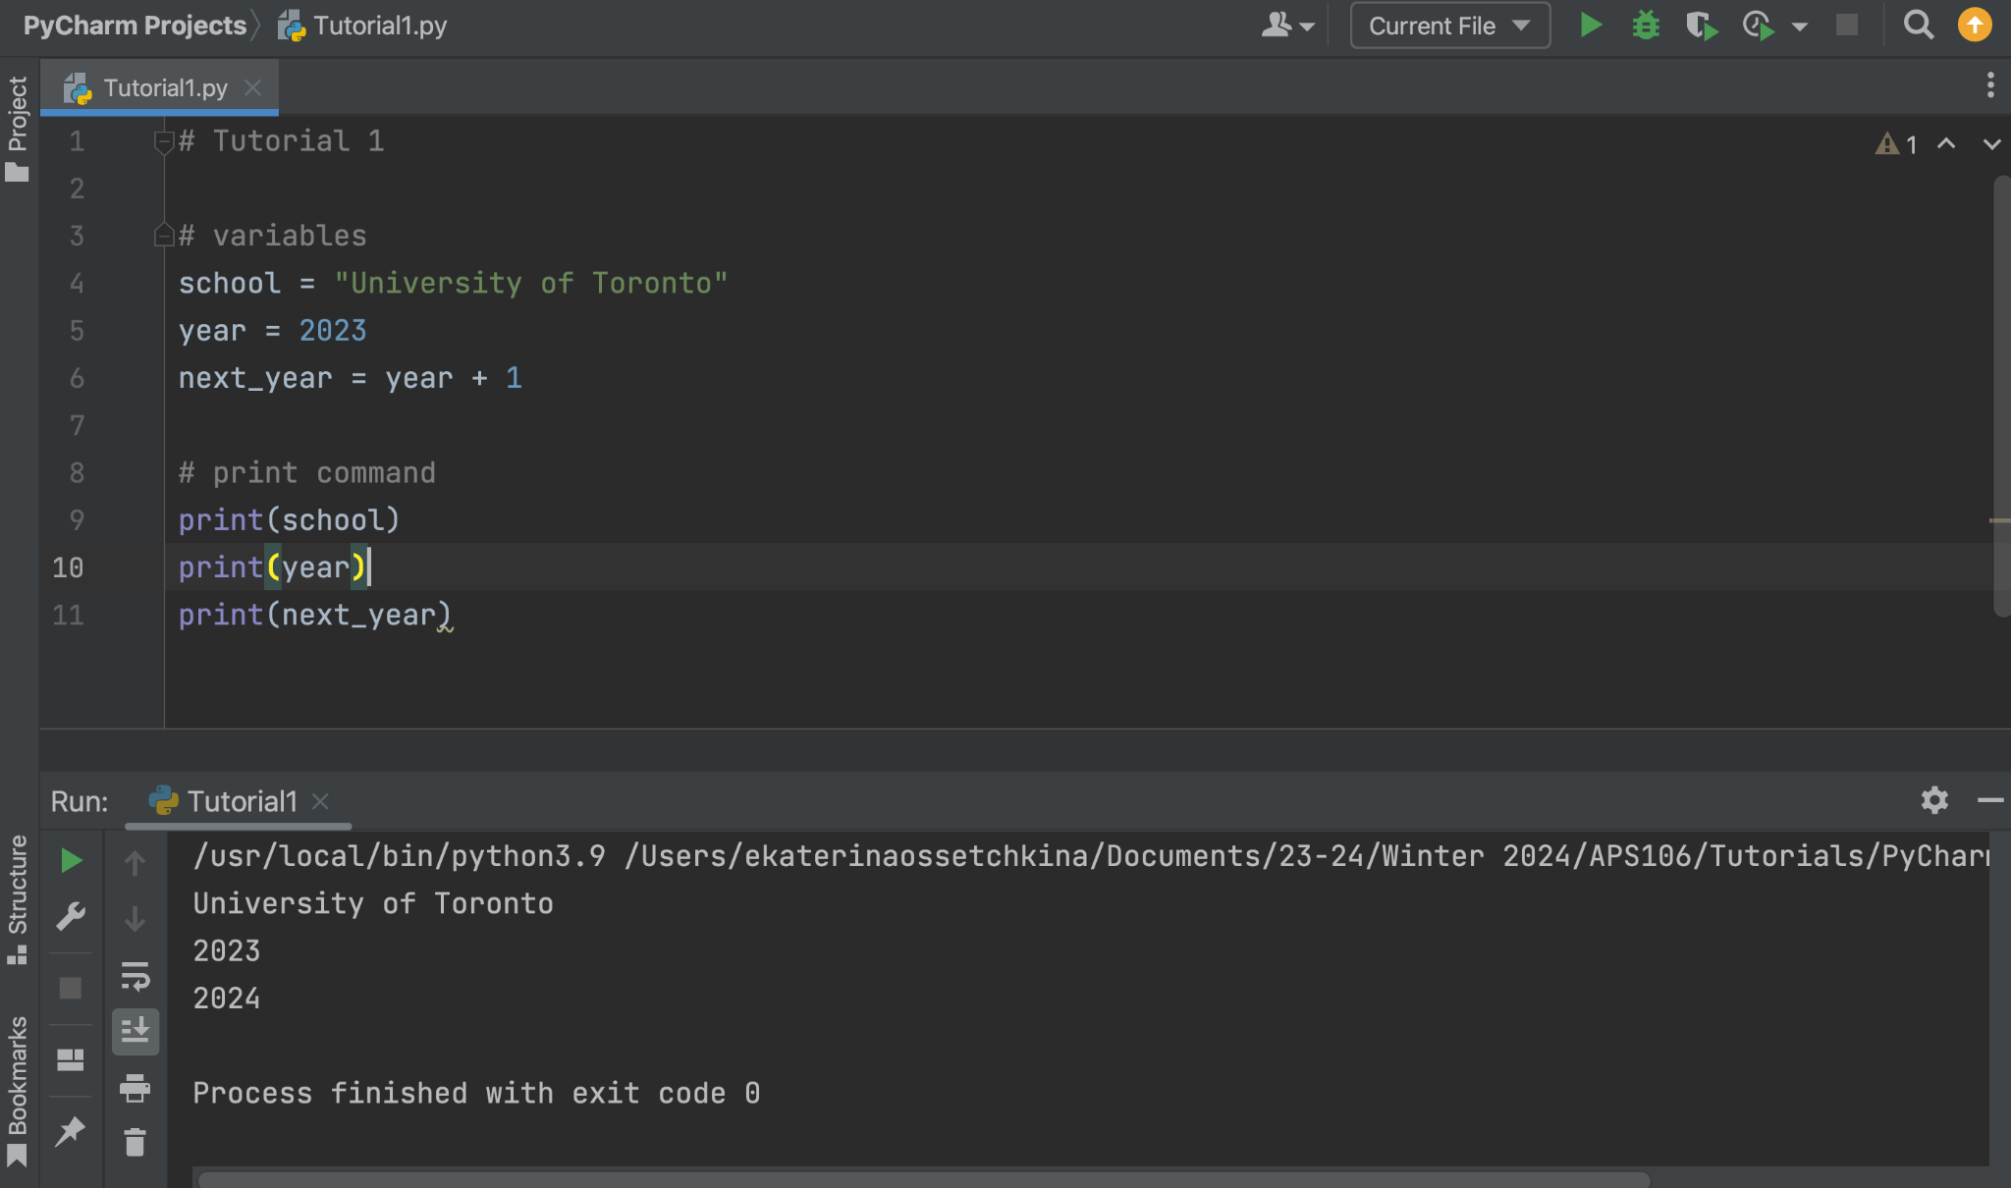
Variables
A variable is a “container” for a value.
Variables are associated with values via assignment statements.
assignment statements in Python: variable_name = expression
In Python:
variable names must:
start with a letter or _
contain only letters, digits or _
variables have types (a variable has the type of the value assigned to it)
Tip: use meaningful variable names !

Slide 20
Python Function print()
In Python, we can use the built-in function print()to display objects/values in the shell.
In particular, we can use print() to display the value of program variables.
TO DO: run this code with and without
the print statements.

Slide 21
Programming Concepts
Operators and Expressions

Slide 22
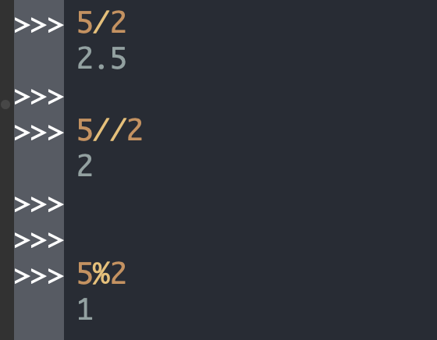
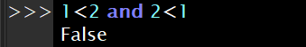
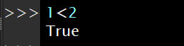
Operators - Basics
Operators are programming constructs that generally behave like functions.
An operator is, generally, represented by a symbol, e.g.: +, /, -, //, %, <,==,>,and
Type | Name | Symbol | Operand Data Type(s) | Arity
arithmetic | integer division | // | Number | binary
arithmetic | modulo | % | Number | binary
relational | less than | < | various types | binary
logical | logical conjunction | and | all data types | binary
Examples of Python operators
Do not worry about these 2 for now

Slide 23
Expressions
An expression is a combination of values (literals), variables, operators, and parentheses.
Python Examples of Simple Arithmetic Expressions | English description | Result
11 + 3 | 11 plus 3 | 14
5 - 19 | 5 minus 19 | -14
7 * 4 | 7 multiplied by 4 | 28
2 ** 5 | 2 to the power of 5 | 32
9 / 2 | 9 divided by 2 | 4.5
9 // 2 | 9 divided by 2 | 4
9 % 2 | 9 mod 2 | 1
Python Operator (symbol) | Name (Operation)
+ | addition
- | subtraction
* | multiplication
** | exponentiation
/ | division
// | integer division
% | modulo (remainder)
An arithmetic expression is an expression that contains numerical values, arithmetic operators and parentheses.
The operators in an un-parenthesized arithmetic expression are evaluated in order of precedence.

Slide 24
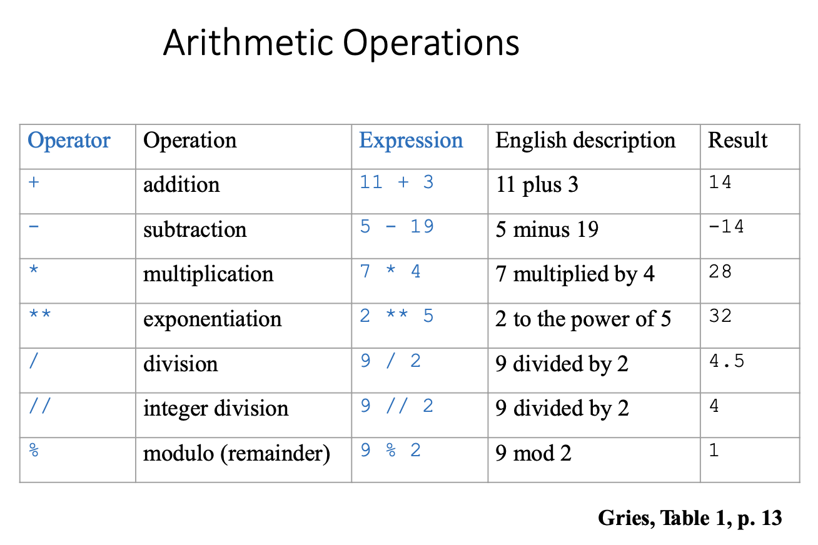
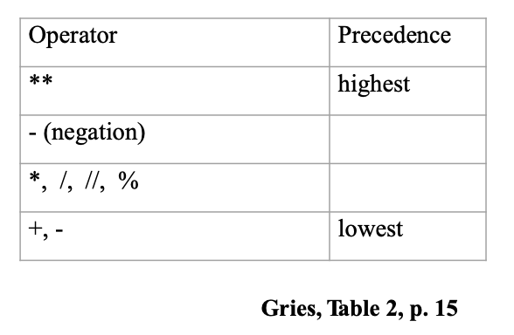
Arithmetic Expressions
Arithmetic expressions follow the same rules learned in math class!
The operators in an un-parenthesized expression are evaluated in order of precedence.

Slide 25
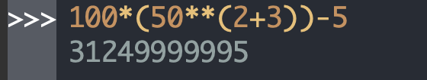
Operator Precedence
Operator | Precedence
** | highest
- (negation)
*, /, //, %
+, - | lowest
Operator precedence, or the order of operations, is a collection of rules about which actions to perform first in order to evaluate a given expression.
For example, in all programming languages, the arithmetic operators, e.g., multiplication, division, integer division, modulo, addition, subtraction, are evaluated according to the order of precedence of their corresponding math operators.
Precedence rules for other operators, e.g., relational operators, are language-dependent !

Slide 26
Give it a try! Arithmetic Operation Examples
Integer division: //
Modulo: %
Arithmetic Precedence

Slide 27
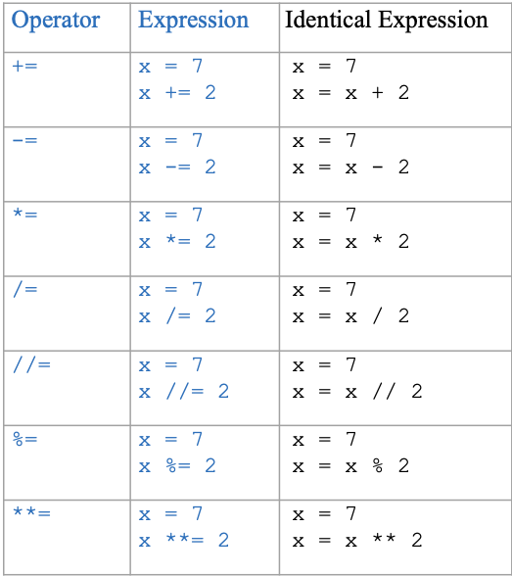
Augmented Operators in Python

Slide 28
Programming Concepts
Errors

Slide 29
Error Types¹
Name | Definition | Timing | Python Examples
Syntax error | An error due to the code not being syntactically valid (i.e., not obeying the grammar of the programming language) | Usually discovered during compilation | >>> (3 + 2 * 4 Syntax Error: unmatched ')’ Expression (3 + 2 * 4 contains an open parenthesis but not a corresponding close parenthesis
Semantic error | An error due to the code not following the semantic rules of a programming language, e.g., when operators are used improperly or when an attempt is made to use a variable that has not yet been associated with a value, or | Usually discovered during compilation | >>> "Hello" - 4 TypeError: unsupported operand type(s) for -: 'str' and 'int’ Operator - cannot be applied to a string and an integer >>> a > 5 NameError: name 'a' is not defined

Slide 30
Error Types²
Name | Definition | Timing | Python Examples
Runtime Error | An error that occurs during the execution (runtime) of a program. | Happens when the code is run, and may halt the execution of the program | >>> a = 5 >>> b = 4 /(a - 5) ZeroDivisionError: division by zero
Logical Error | An error that results from the code not conforming to its intended semantics due to, e.g., a formula being implemented incorrectly, a block of code being indented erroneously, the programmer misunderstanding and implementing incorrectly a requirement. | Happens when the code is run. May remain undiscovered. | >>> duration_in_seconds = duration_in_hours * 100 The formula for converting hours into seconds is incorrect

Slide 31
Practice Problems

Slide 32

What does the following code output?
ⓘ
Click Present with Slido or install our Chrome extension to activate this poll while presenting.
Notes:
📣 This is Slido interaction slide, please don't delete it. ✅ Click on 'Present with Slido' and the poll will launch automatically when you get to this slide.

Slide 33
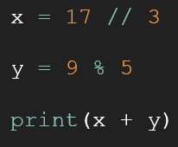
Review Practice Problem 1
What does the following code output?
7.47
9
5 4
6
None of the above

Slide 34
What does the following code output?
ⓘ
Click Present with Slido or install our Chrome extension to activate this poll while presenting.
Notes:
📣 This is Slido interaction slide, please don't delete it. ✅ Click on 'Present with Slido' and the poll will launch automatically when you get to this slide.

Slide 35
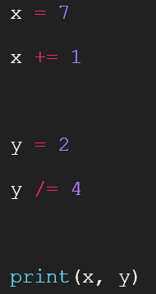
Review Practice Problem 2
What does the following code output?
1 4
7 2
1 0
8 0.5
None of the above

Slide 36
What is the output from this code?
ⓘ
Click Present with Slido or install our Chrome extension to activate this poll while presenting.
Notes:
📣 This is Slido interaction slide, please don't delete it. ✅ Click on 'Present with Slido' and the poll will launch automatically when you get to this slide.

Slide 37
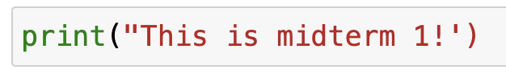
Review Practice Problem 3
What is the outcome of running this code?
'This is midterm 1'
This is midterm 1
Logical error
Semantic error
Syntax error

Slide 38
What is the outcome of running this code?
ⓘ
Click Present with Slido or install our Chrome extension to activate this poll while presenting.
Notes:
📣 This is Slido interaction slide, please don't delete it. ✅ Click on 'Present with Slido' and the poll will launch automatically when you get to this slide.

Slide 39
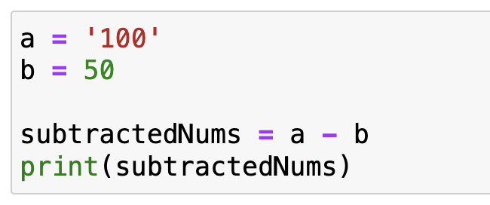
Practice Problem 4
What is the outcome of running this code?
A logical error occurs
50
A runtime error occurs
A semantic error occurs
A syntax error occurs

Slide 40
What is the outcome of running this code?
ⓘ
Click Present with Slido or install our Chrome extension to activate this poll while presenting.
Notes:
📣 This is Slido interaction slide, please don't delete it. ✅ Click on 'Present with Slido' and the poll will launch automatically when you get to this slide.

Slide 41
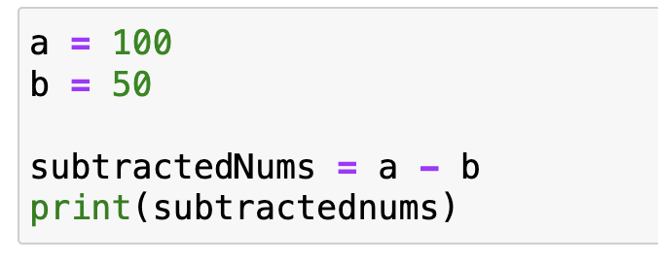
Practice Problem 5
What is the outcome of running this code?
A logical error occurs
50
A runtime error occurs
A semantic error occurs
A syntax error occurs
NOTE! print() must have a valid parameter inside
Notes:
Emphasise that something has to be inside

Slide 42
Learning Objectives
Upon completing this tutorial, the students will be able to:
use Wing 101 effectively
understand the concept of value / type / variable / operator / expression / error
recognize values / types / variables / operators / expressions / errors
define values (literals) / variables
use values, variables and operators (to define expressions)
evaluate simple expressions
fix basic errors
Notes:
Put this before questions?

Slide 43

Any questions?
ⓘ
Click Present with Slido or install our Chrome extension to activate this poll while presenting.
Notes:
📣 This is Slido interaction slide, please don't delete it. ✅ Click on 'Present with Slido' and the poll will launch automatically when you get to this slide.

